Slide 1
Front End Engineering-I Project
Team Details:
Tarandeep Singh 2310992228
Tanish Rajput 2310992225
Tanisha Singh 2310992226
Faculty Coordinator: Dr. Shanky Goyal
:
Chitkara University Institute of Engineering and Technology,
Chitkara University, Punjab

Slide 2
Table of Contents
Introduction
Problem Statement
Technical Details
Key Features
Project Highlights
Bonus Feature(optional)
Conclusion
References/Links used

Slide 3

Introduction
Survey and Polling Website
The main objective of this project is to make a user friendly website on which the surveys and polls can be given and conducted. In our website any organisation can create a survey and poll and that survey and polls can be given in same website itself.

Slide 4

Problem Statement
PROBLEM
The main problem of that we want to solve is the unmanaged system of conducting polls and surveys. If a organisation or a user want to conduct a survey or poll, he might not able to conduct polls efficiently and effectively, because of lack of technology and software support

Slide 5

Technical Details
For making this polling and survey application we have used technologies like HTML and CSS. This website is lightweight and is designed to work on most of the devices ensuring that they work seamlessly across all platforms. We use CSS transitions to make this website more attractive and visually appealing.

Slide 6

Key Features
User-friendly interface for easy navigation.
Fast and interactive.
Integration with various platforms and systems.
Advanced analytics of polls and surveys.

Slide 7

Project Highlights
This website contains 3 tabs(Home, About, Contact) and image(logo) in the nav tag.
Followed by a heading which is created by <h1> tag followed by styling in css
Then there are two buttons, one to create suvey(this is currently under development), Second tab automatically redirects to a survey (which coding ninjas had to conduct on our website). There is currenty no verification of survey taking place as no backend is written.

Slide 8

Project Highlights
Below the header section there is a footer section, in which there is heading created by <h3> tag.
Then there is a paragraph tag created by <p> tag
Text styling by css background color and text align properties.
Then there are icons, which redirects to sample social media pages (in a new tab)
Page ends with a copyright symbol which is added using &#169 code.

Slide 9
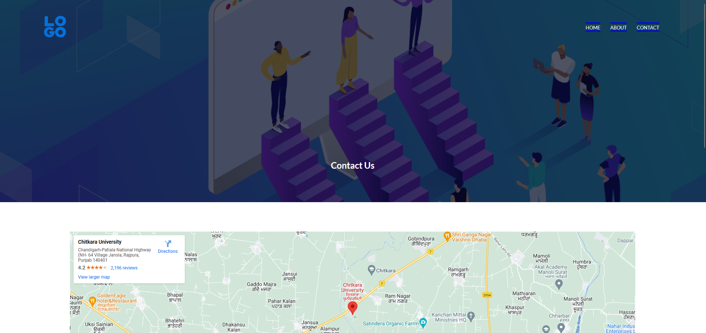
Project Highlights
In contact us page the map is added by going to google maps, and then copying iframe link from the , embed on page section, and height and width is adjusted using css height and width properties.

Slide 10

Project Highlights
The icons are added using the font awesome library, and in the above picture there are two div(one containing image and other one containing addresses)

Slide 11
Conclusion
As a conclusion I would say that we have created optimized and responsive website.
We have also tried to solve problem of conducting polls and surveys with our innovative approach.
As a team we have learned a lot of things from this project like implementing HTML and CSS to make things to solve real world problems.
We will also learn a lot of new things in the future while working on this project.

Slide 12
References/Links used
Google
W3Schools
MDN Web Docs.
Font Awesome library (for icons)
Youtube Channels (for troubleshooting)
Chat GPT 3.5 (for debugging)

Slide 13


